Slide 1
The Internet, and IT Security
Muhammad Ali

Slide 2
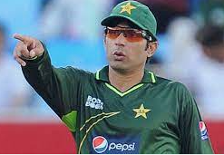

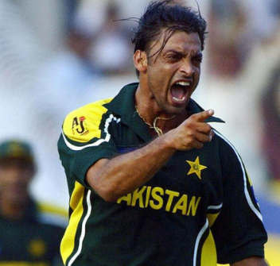
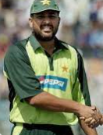

Human Network
Network:
a group or system of
interconnected people or things
Notes:
Pakistani Cricketers Network example

Slide 3
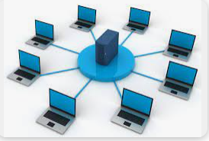
Computer Network
Number of Device Connected with each other may or may not sharing data through Medium Such as communication links or routers (fiber optics, satellite)
Network example: you want to play game in which you need some friends. CS go or PUBG or facebook

Slide 4
Protocol
Q: How Babar ask for help?
Ans: Through Urdu language(Language =protocol)

Slide 5
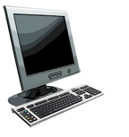

What’s a protocol?
a human protocol and a computer network protocol:
Hi
TCP connection
request
Hi
TCP connection
response
Got the
time?
Get http://www.awl.com/kurose-ross
2:00
<file>
time
Q: other human protocols?
protocols define format, order of messages sent and received among network entities, and actions taken on message transmission, receipt . E.g. HTTP
Introduction
1-5

Slide 6
Internet
Internet: “network of networks”
Interconnected ISPs
Data communication: “Data communication is the exchange of data between two devices, made up of hardware/physical equipment and software/program”
e.g. Data transmission medium such as a
wire cable or (wireless).

Slide 7
Search Engine
Search Engine: A search engine is a kind of website through which users can search the content available on the Internet.
Then the search engine looks through its index for relevant web pages and displays them in the form of a list.
Some of the popular ones are: Google, Bing, Yahoo, Duck duck go, Baidu, etc.

Slide 8
Three main components of the Search engine
Crawler: They are responsible for finding information that is publicly available on the internet. They scan the list and create a list of all websites. They visit each page of a website and extract the structure of page, the type of content, the meaning of content, when it was updated and created
Index: Information identified by crawlers needs to be organized, sorted and stored.
Search Algorithm: It is working by searching for the index and finding for the most suitable webpages by matching keywords that are searched by the users. It analyzes user query, finding matching pages and present the results to users.

Slide 9
Web Browser
Web Browser: The web browser is an example of application software that is developed to retrieve and view the information from web pages or HTML files present on the web servers
Microsoft’s internet explorer, Google Chrome, Mozilla Firefox, Opera and Apple safari.

Slide 10
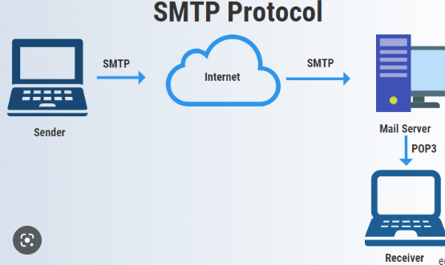
Email (Electronic mail)
is a communication method that uses electronic devices to deliver messages across computer networks.

Slide 11
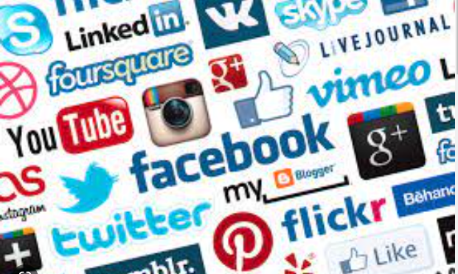
Collaboration and Social Networking sites
A collaborative network is a network consisting
of a variety of entities that are largely autonomous, geographically distributed, and heterogeneous in terms of their operating environment, culture, .
Facebook
Linkedin
youwube

Slide 12


Ecommerce
Ecommerce or electronic commerce is the trading of goods and services on the internet

Slide 13
Why we need IT Security
Reducing the risk of data breaches and attacks in IT systems. [readteam]
Applying security controls to prevent unauthorized access to sensitive information. [readteam]
Preventing disruption of services, e.g., denial-of-service attacks. Protecting IT systems and networks from exploitation by outsiders[readteam]

Slide 14

IT Security
Information security, sometimes shortened to InfoSec, is the practice of protecting information by mitigating information risks. [wiki]
OR
Ensure confidentiality, Integrity and availability of information system such as hardware software etc. [NIST]
IT Security

Slide 15
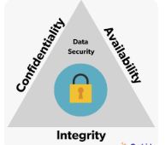
What is CIA?
Three most important concept of security are CIA: CIA stands for Confidentiality, Integrity and Availability

Slide 16
Key Security concept (CIA)
Confidentiality measures are designed to prevent sensitive information from unauthorized access attempts. Such as photo, videos, transaction etc. [wiki]
Integrity means that data or information in your system is maintained so that it is not modified or deleted by unauthorized parties. [wiki]
Availability means that systems and data are available to individuals when they need it under any circumstances, including power outages or natural disasters. [wiki]

Slide 17
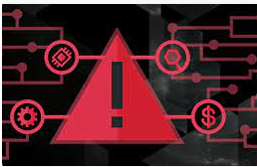
Threat
Represents Potential security harm to an Asset

Slide 18
Vulnerabilities
Corrupt: loss of integrity
Leaky (loss of confidentiality)
Unavailability: (Loss of availability)

Slide 19
Attack and Attack types
Any kind of malicious activity that attempts to collect, disrupt, deny, degrade, or destroy information system resources or the information itself. [csrc]
Types of Attack:
Passive Attack: Attack in which a system is monitored and sometimes scanned for open ports and vulnerabilities
Active Attack: Attempt to alter resources or affect operation

Slide 20
Top 5 IT Security Attacks and challenges
Software vulnerabilities
Ransomware attack
Phishing Attack
Cloud and IoT attack
Network Attack

Slide 21
Countermeasure in IT security
Countermeasure means deal with security attacks
Countermeasures are:
1. Prevent Attack such as backup data or encrypt data
2. Detect Attack using detection tools like snort
3. Recover the loss after attack (insurance)

Slide 22
Job of IT Security
There are four types of information technology security high paid you should consider or improve upon:
Network Security.
Cloud Security.
Application Security.
Internet of Things Security.

